Slide 1
Context-free Grammars
Describing the syntax of programming languages

Slide 2
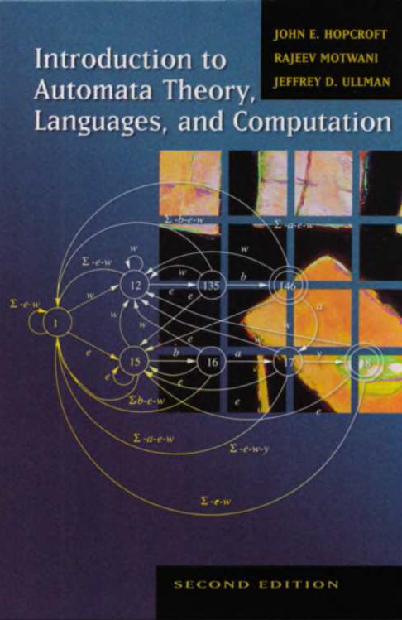


Slide 3
motivation
The problem solved by context-free grammars.

Slide 4
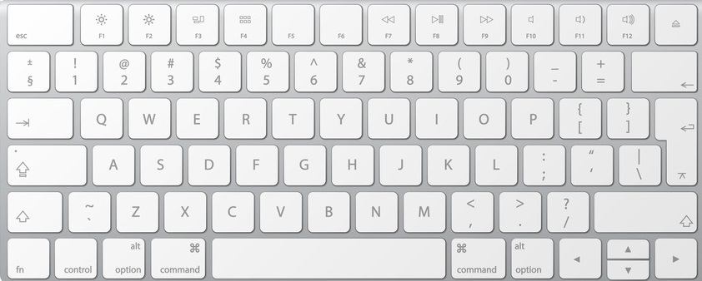
Characters and strings
We define a string as a sequence of zero or more symbols belonging to an alphabet Σ.
When writing software a keyboard provides the means for generating the symbols in Σ and for generating strings.

Slide 5
Kleene Closure
We define the set Σ* to be the set of all strings (length 0 or more) that can be created using the symbols in Σ.

Slide 6
The set of binary strings
Let Σ = { 0, 1 }
Σ* = { ε, 0, 1, 00, 01, 10, 11, … }

Slide 7
The set of Ternary strings
Let Σ = { 0, 1, 2 }
Σ* = { ε,
0, 1, 2,
00, 01, 02, 10, 11, 12, 20, 21, 22,
…
}

Slide 8
The Execution Models of Compilers and interpreters
The source-code of a program is, technically speaking, a string.
Option 1 - Bring the code to the machine.
A compiler translates (i.e., compiles) the source-code of (high-level) programs, which cannot be directly executed by a computer, into corresponding low-level programs, which can be directly executed by a computer.
Option 2 - Bring the machine to the code.
An interpreter executes the source-code of high-level programs. This execution is accomplished through a set of abstractions.

Slide 9
Well-formedness
Let p denote a string that we wish to execute. There are two options:
Compile p and execute the result.
Interpret p.
Not every string is a program.
A string p should only be executed if it is well-formed.
To be well-formed a string must satisfy a variety of syntactic and semantic properties.

Slide 10
continued
We say p is syntactically well-formed if p satisfies the necessary syntactic properties.
A parser is a program that determines whether p is syntactically well-formed.
We say p is semantically well-formed if p satisfies the necessary semantic properties.
Type systems (and other forms of analysis) determine whether p is semantically well-formed.

Slide 11
Context-free grammars
Context-free grammars provide a formalism for specifying the properties a string must satisfy in order to be syntactically well-formed.
A context-free grammar G can be used to define a set of syntactically well-formed strings.
In this context, we refer to the set of strings defined by G as a language.
We write L(G) to denote the language defined by G.

Slide 12
parsing
Let L(G) denote the language in which we are interested.
For a given string p, if p ∈ L(G) then p is syntactically well-formed.
Context-free grammars let us reduce a syntactic well-formedness problem to a set membership problem.
A parser for L(G) is a program, based on a context-free grammar G, that is capable of answering the set membership question for L(G).

Slide 13
Parser generators
A parser generator is a program that when given a grammar G will produce a parser that is able to decide the set membership problem for L(G).
The TL system used for the class project provides a powerful GLR parser generator.

Slide 14
Intuition
Using a text-editor to understand the mechanics of context-free grammars

Slide 15
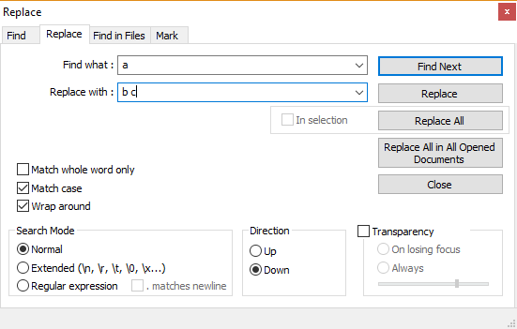
Find and Replace
We will write a ::= b c to denote a text editor find-and-replace rule which specifies that the symbol “a” is to be replaced by the symbol sequence “b c”.
We are particularly interested in the exhaustive application of find-and-replace rules.

Slide 16
Basic Concepts
Perform a single replacement of a symbol (e.g., a character) with a sequence of zero or more symbols (i.e., a string).
We will refer to a single find-replace operation as a derivation step.
Symbol recognition is an equality check
Finding a symbol in a document.
Search from cursor position down (i.e., towards the end of the document)
Search from cursor position up
Search from beginning of document

Slide 17
Derivations
We use the symbol ⇒ to denote a derivation step.
A derivation step can be formally understood as a binary relation over the set of strings whose symbols are drawn from Σ.
We will use ⇒∗ to denote the reflexive transitive closure of ⇒.

Slide 18
(reflexive)
α ⇒∗ α
α ⇒ β β ⇒∗ δ
(transitive)
α ⇒∗ δ

Slide 19
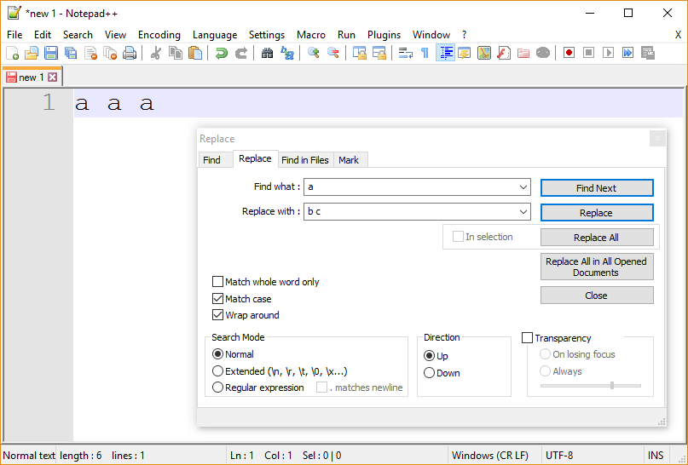

Slide 20
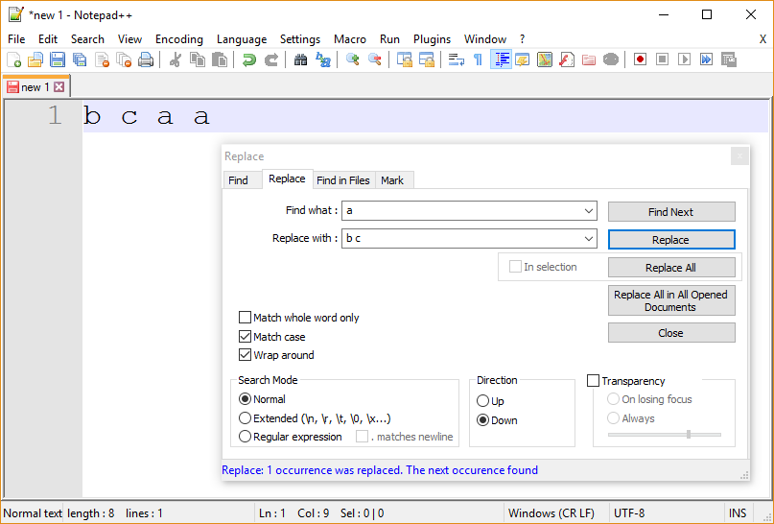
a a a ⇒ b c a a

Slide 21
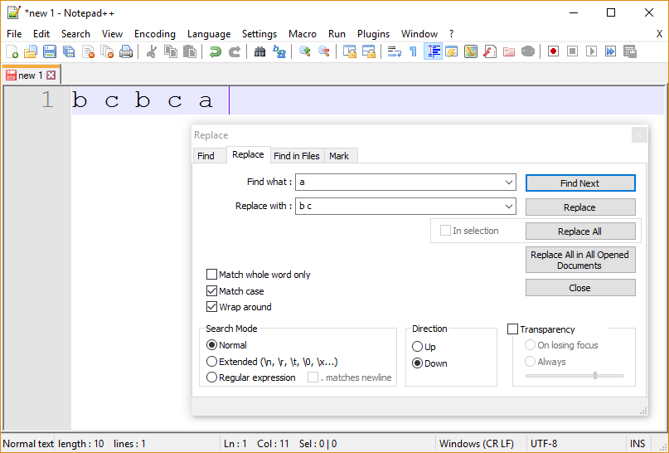
(a a a ⇒) b c a a ⇒ b c b c a

Slide 22
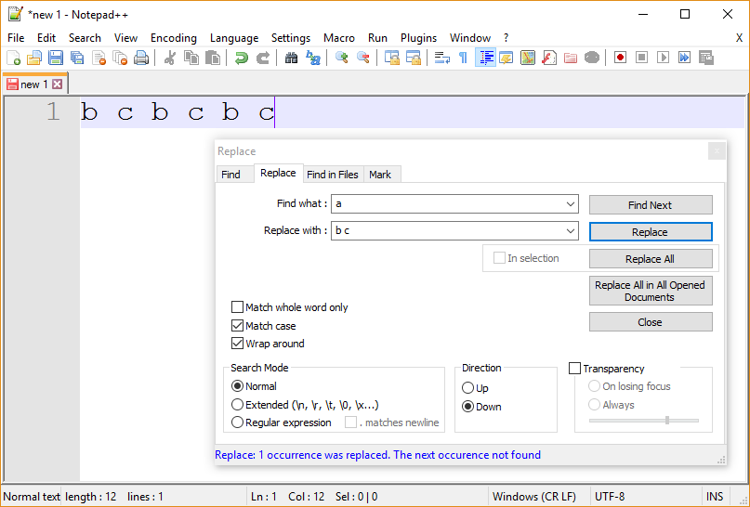
(a a a ⇒ b c a a ⇒) b c b c a ⇒ b c b c b c

Slide 23
Symbols versus characters
A symbol consists of 1 or more characters
White space is used to separate symbols
“Together” – one symbol consisting of 8 characters
“To” “get” “her” – three symbols
Our find-replace rules will have the following form.
lhs ::= rhs
lhs consists of a single symbol
rhs consists of zero or more symbols

Slide 24
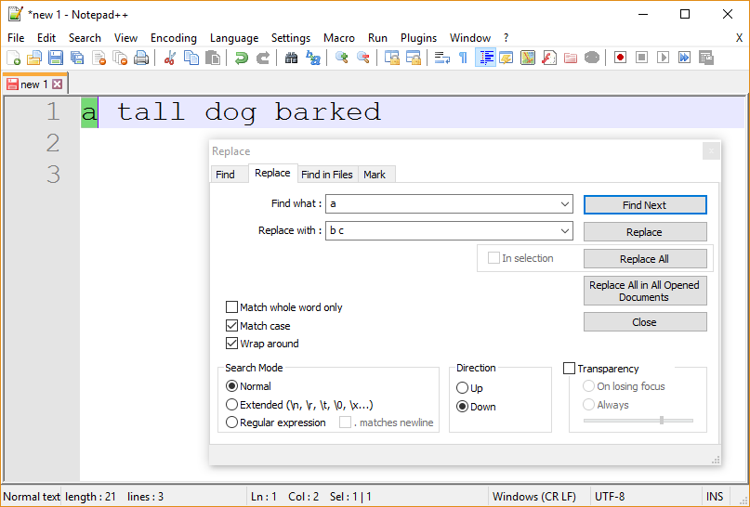

Slide 25
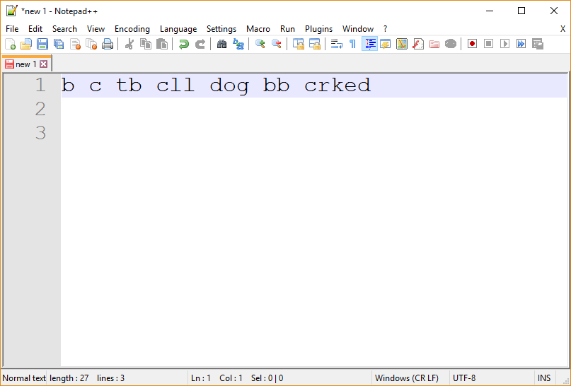

Slide 26
Markers
In addition to spaces other “reserved” symbols can be used to distinguish symbols.
For example, pointy-brackets can be used to define symbol boundaries.

Slide 27
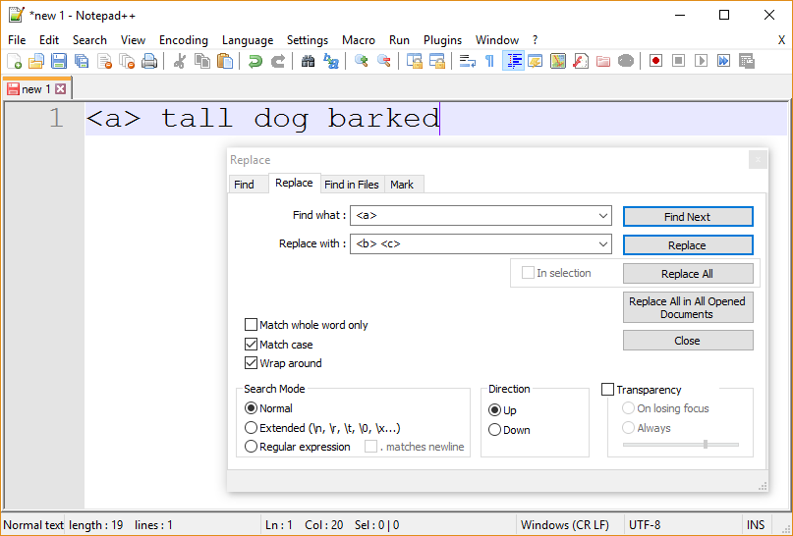

Slide 28
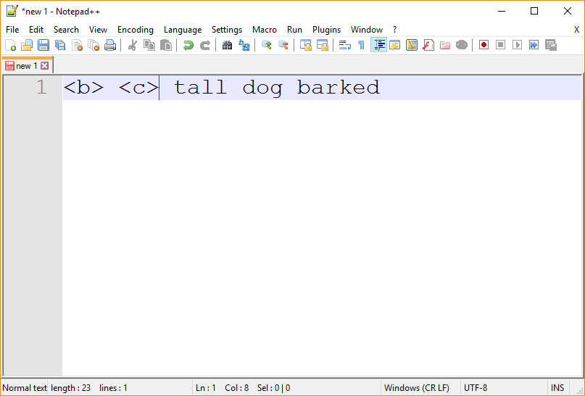

Slide 29
observation
Let us assume that spaces are used to separate symbols.
Under this assumption, not all symbols need to be enclosed in pointy-brackets.
Only symbols that occur on the lhs (i.e., the “find what” part) of a find-and-replace rule need be enclosed in point-brackets.
Symbols that occur on the lhs of a rule are called nonterminal symbols.

Slide 30
From a technical standpoint, the use of pointy-bracket delimiters are needed only to compensate for how the find-replace function of the text editor is implemented.
Specifically, the find-replace function is character based.
It does not use blank space to group characters into symbols.

Slide 31
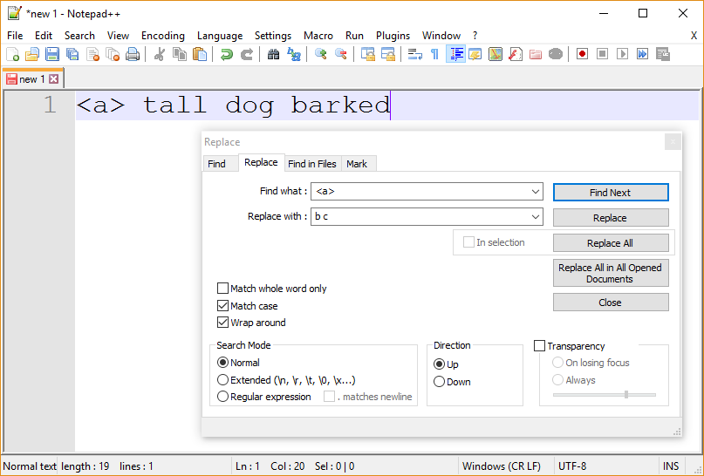

Slide 32
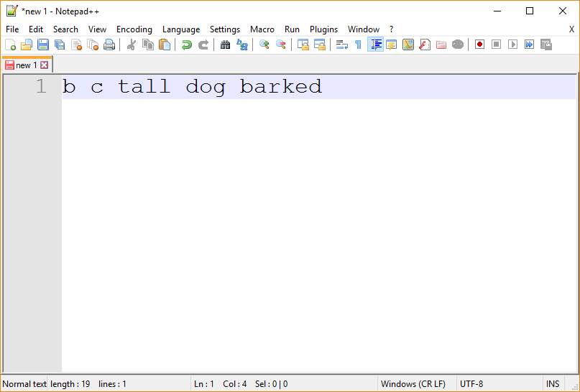

Slide 33
Recursive rules
A find-replace rule is recursive if the lhs occurs in the rhs.
The use of pointy-brackets to delineate a nonterminal symbol must be consistent (i.e., complete).
Specifically, all occurrences of a nonterminal must be enclosed in pointy-brackets.

Slide 34
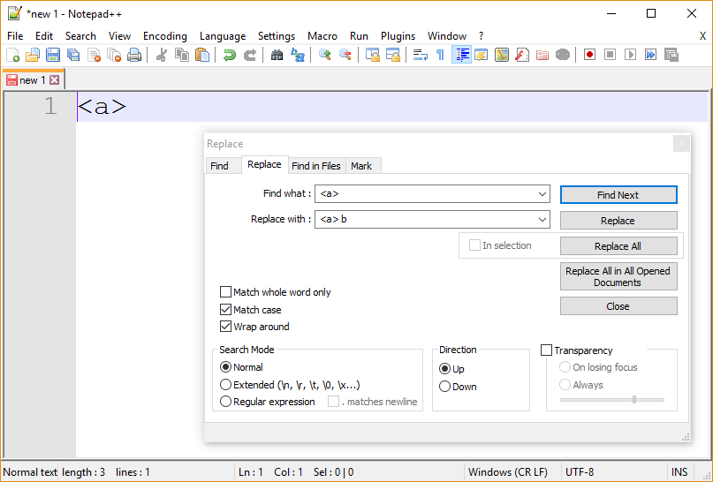

Slide 35


Slide 36
Epsilon
It is possible for a find-replace rule to replace a symbol with nothing (i.e., a string whose length is zero).
We will us the symbol ε to denote a string whose length is 0.
For example, <a> ::= ε denotes a find-replace rule in which the symbol <a> is to be replaced by ε.

Slide 37
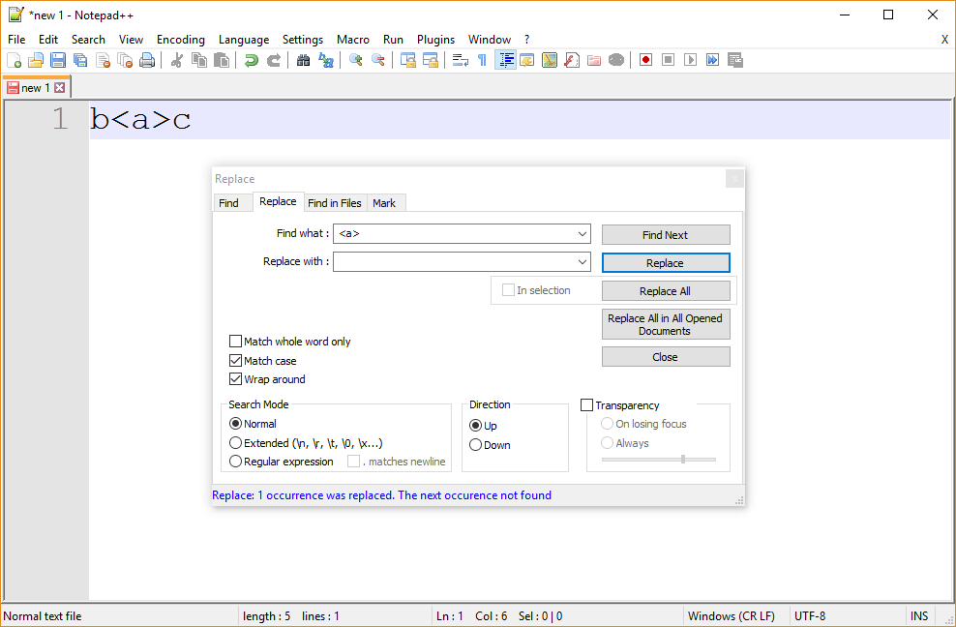

Slide 38
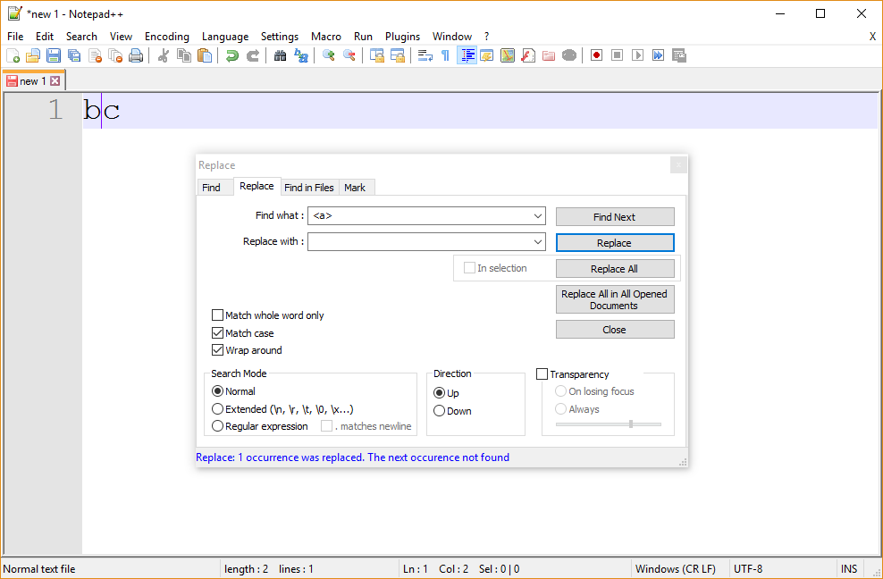
Note that ε ≠ blank

Slide 39
The End

